Slide 1
ARCHITECTURE OF 8086 MICRO PROCESSOR
P.RAJESH M.Tech.,
ASST PROFESSOR
DEPT OF ECE
CRIT COLLEGE OF ENGG

Slide 2
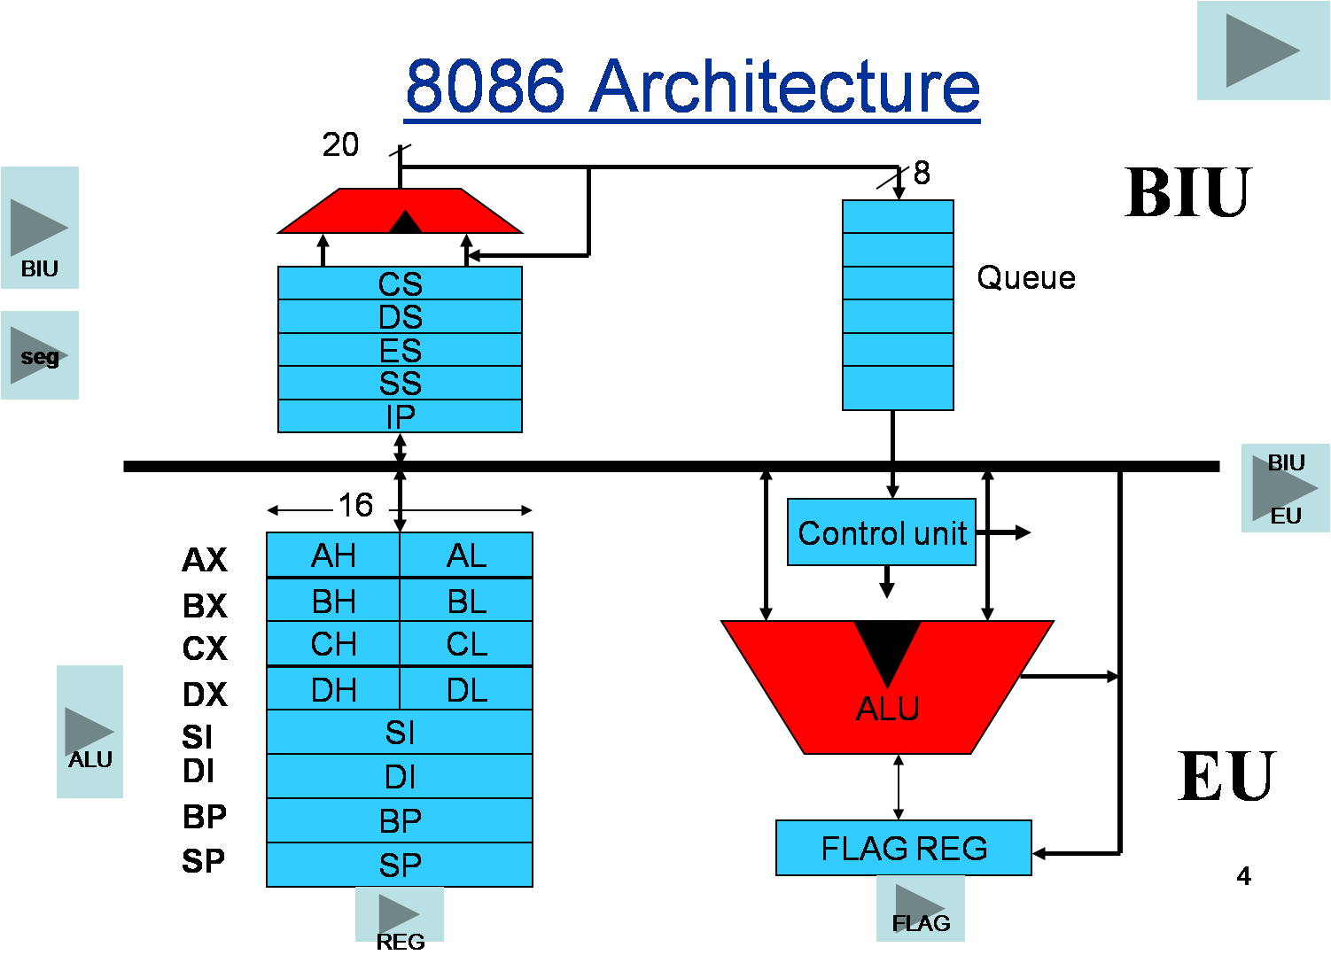

Slide 3
8086 microprocessor has two units;
A) Bus Interface Unit (BIU) and
B) Execution Unit (EU).
They are dependent and get worked by each other.

Slide 4
Execution Unit (EU) : Execution unit receives program instruction codes and data from the BIU, executes them and stores
the results in the general registers. It can also store the data in a memory location or send them to an I/O device by passing the data back to the BIU. This unit, EU, has no connection with the system Buses. It receives and outputs all its data through BIU.
ALU (Arithmetic and Logic Unit) : The EU unit contains a circuit board called the Arithmetic and Logic Unit. The ALU can perform arithmetic, such as, +,-,×,/ and logic such as OR, AND, NOT operations.

Slide 5
Registers : A register is like a memory location where the exception is that these are denoted by name rather than numbers.
It has 4 data registers, AX, BX, CX, DX and
2 pointer registers SP, BP and
2 index registers SI, DI and
1 temporary register and
1 status register FLAGS .
AX, BX, CX and DX registers has 2 8-bit registers to access the high and low byte data registers.
The high byte of AX is called AH and the low byte is AL. Similarly, the high and low bytes of BX, CX, DX are BH and BL, CH and Cl, DH and DL respectively.
All the data, pointer, index and status registers are of 16 bits.
Else these, the temporary register holds the operands for the ALU and the individual bits of the FLAGS register reflect the result of a computation.

Slide 6
Bus Interface Unit : As the EU has no connection with the system Busses, this job is done by BIU. BIU and EU are connected with an internal bus. BIU connects EU with the memory or I/O circuits. It is responsible for transmitting data, addresses and control signal on the busses.
Registers : BIU has 4 segment busses, CS, DS, SS, ES. These all 4 segment registers holds the addresses of instructions and data in memory. These values are used by the processor to access memory locations. It also contain 1 pointer register IP. IP contains the address of the next instruction to executed by the EU.

Slide 7
Instruction Queue
BIU contains an instruction queue. When the EU executes instructions, the BIU gets up to 6 bytes of the next instruction and stores them in the instruction queue and this process is called instruction prefetch. This is a process to speed up the processor. A subtle advantage of instruction queue is that, as next several instructions are usually in the queue, the BIU can access memory at a somewhat "leisurely" pace. This means that slow-memory parts can be used without affecting overall system performance.

